Slide 1
The Justice Academy

Slide 2
Thematic Analysis
Introduction to Thematic Analysis
One of the features of Geographic Information Systems which possesses the greatest degree of utility is the thematic analysis option. Thematic Analysis is used to support the descriptive analysis needs of the researcher by colorizing various geographic regions based upon the values contained within the database. Thematic analysis offers an effective method of visualizing your data by graphically displaying the information so that you can see the patterns which develop and provides for a comparison between regions and points based on a prescribed set of value ranges. Thematic mapping is the process of shading your map according to a particular theme. The theme is usually some piece or pieces of your data. Shading in this context is a very general term that refers not only to shades of color, but also to fill patterns, symbols, or the thematic method you are using to display your data on the map (i.e. pie charts or bar charts). With MapInfo, you create different thematic maps by assigning these colors, patterns, or symbols to map objects according to specific values in your table. The thematic feature uses a series of three dialogs to help you choose the type of thematic map you want, the table(s) and fields that will be used to construct the map, and a variety of options to customize your map.

Slide 3
Thematic Variables The data that you display on your thematic map is called the thematic variable. Depending on the type of thematic analysis you are performing, your map can show one or more thematic variables. Ranges of values, graduated symbols, dot density, and individual value maps all examine one variable. With bar and pie charts, you can display more than one thematic variable at a time. A thematic variable can also be an expression which is constructed using Structured Query Language. Choose it in place of a data field to construct a statement that derives information from the data in your table(s) for your thematic variable. Although an expression can be made up of more than one variable, for purposes of thematic mapping, a complete SQL expression is equivalent to one thematic variable. There are generally six methods of thematic analysis, depending on the manufacturer: Ranges of Values This type of thematic analysis can be applied to map or boundary file layers and involves the specification of determinant frequencies to facilitate the colorization process. In other words, the researcher specifies that for those observations that are between 0 and 1000, a blue color is to be assigned, while those regions which possess a frequency count of 1001 to 5000 should be colored using a red shade. This process forces the GIS system to analyze all of the values within the database and categorizes them based upon raw frequency. All of those areas which fall into the first category will be assigned a blue color and all of those regions which had a value greater than 1001 were assigned a red color. This "Range of Values" process is the most common form of thematic analysis.

Slide 4
Graduated Symbols This form of thematic map varies the actual size of the dots used to profile the location of an object. Although not particularly accurate relative to the spatial axiom, graduated symbol mapping is an effective method of visualizing information and concentrates upon accentuating the differences between objects relative to frequency counts. An effective example might involve the comparison of populations. Remember that GIS systems use an icon to represent the spatial location of records on the map. For boundary file types of examinations, the icon is placed at the centroid of the boundary. Using the graduated symbol form of thematic analysis, the GIS software increases or decreases the size of the icon used to display the records depending upon the frequency encountered. A extremely large icon would be used for major urban centers, while small icons will be used to indicate rural regions. Again, although effective at illustrating the differences between regions based upon frequency counts, this graduated symbol form of thematic analysis is spatially inaccurate.

Slide 5
Dot Density Dot Density forms of thematic analysis can also be referred to as a "cluster analysis" form of visualization. In its purist sense, cluster analysis is based upon the actual spatial location of objects relative to one another and uses exact spatial location. By geocoding databases to maps and then by viewing the spatial placement and proximity of these icons to one another, the researcher is conducting a cluster analysis. Dot density thematic analysis differs from proximity comparison in that it is used in conjunction with boundary files rather than map files. In essence, each record of the database is geocoded to a particular region based on the comparison of the value contained within the spatial key of the database and the list of potential values in the boundary file. After successfully geocoding the database file to the boundary, a dot density based thematic analysis will display one dot for each observation within a particular sub-region. The more observations you have, the greater the number of dots will be displayed. You can modify this form of analysis so that one dot represents 10 or 100 observations or any value you prescribe. This flexibility allows you to construct maps which more effectively represent the phenomena under study and which avoid saturating a region with so many dots that you are no longer able to see any separation.

Slide 6
Individual Values This form of thematic analysis should only be used for databases which contain a low number of observations. Using individual range thematic analysis, GIS systems will assign an individual color to each observation which will subsequently have a severe impact on computer resources. If for example you were using this technique and had to represent 5000 observations, you could expect that the number of colors used to represent these data would be so indifferent that the computer would be unable to comply with your request. If the computer system you are using is SVGA and can generate 16 million colors, the computer will proceed with its task for many, many hours, but the result of the analysis will be indistinguishable and subsequently useless. Again, only use this form of thematic analysis when there are a small number of records contained within the database.

Slide 7
Bivariate thematic comparison Bivariate thematic mapping uses point and line objects to represent two thematic variables. For example, a star can represent one variable, such as the number of teenagers, while a blue fill for the star represents their annual purchasing power. To create a bivariate map in MapInfo, you create two thematic maps, and layer one over the other so that the objects display two variables. This form of analysis is very effective for displaying multiple independent variables. The limitation is that each layer of the thematic can only reflect the values of two variables at a time. Inflection point analysis In thematic analysis, an inflection point is a color style that you insert between two ranges. It provides a second way to interpret your data. The inflection point is placed where there is a distinct marker between the ranges of values above it and the ranges of values below it, or where a numeric shift in the data occurs. Most often, the inflection point is inserted as close to the zero value as possible, since zero marks the shift between positive and negative values, or at the mean of your data values. The inflection point enables you to see this shift on the map. You see two different color spreads in your ranges. Instead of spreading toward each other, the top and bottom range colors both approach the color of the inflection point.

Slide 8
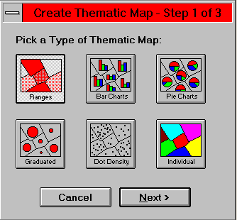
The Basic Methodology of Thematic Analysis Construction
Before you can begin to construct your thematic map, you need to decide what information you want to display and locate where that information resides. After opening the mapfile or boundary file that you will use, you should open the database which corresponds to the map or boundary and make sure that the database has been geocoded to the proper layer. Once this process has been completed, you are ready to begin the thematic analysis process. The first step in the process is to choose the "Create Thematic Map" option from the "Map" dialog. At this point, MapInfo will prompt you for the style of thematic you wish to create. You can choose one of the six options of thematic analysis cited earlier.

Slide 9
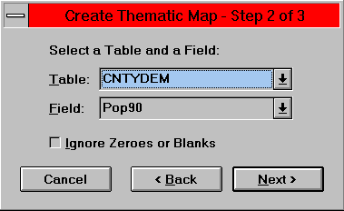
For this example we will choose the range option and we will use the "County" boundary file and the "CNTYDEM" database which profiles demography patterns of the United States. MapInfo will now prompt you to select a table and a field which will be used to construct the thematic map.
In this example we will use the default values (i.e., the CNTYDEM table and the Pop_90 attribute). By pushing the down arrows on the right side of the selection boxes, you can alter you choice of database table or field. After deciding upon the table and field to be used, MapInfo will calculate the potential range of values for the database selected. When finished, it will return a dialog box that seeks your recommendations about how to handle the results it has developed. At this point, MapInfo wants to know if you are satisfied with its choices.

Slide 10
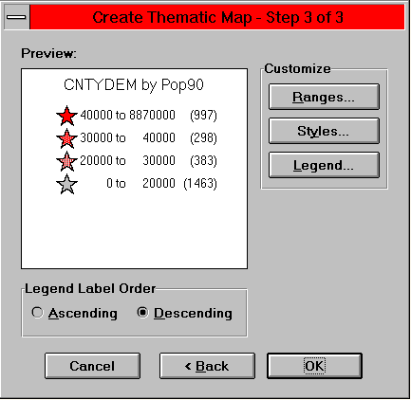
If you wish to modify the icons to be used, the colors to be selected, or the frequency ranges to be included, you must push the appropriate buttons and modify the selections accordingly. This is a very intuitive process and MapInfo makes the process of change and correction very simple. For this example, we will leave the default values in place and we will see that MapInfo changes the color and style of the icons used within the centroid of each sub-boundary region to reflect the calculations it made relative to the population frequency.

Slide 11
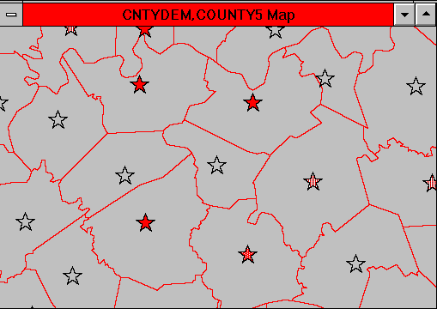
You'll notice that MapInfo simply changed the icon within the boundary. It did not color the entire boundary. This was caused because we chose the thematically analyze the CNTYDEM database and not the County5 boundary file. Had we wished to colorize the boundary region, rather than the icon, it would have been necessary to "Join" the two tables by selecting County5 as the table to be used to thematically render and by selecting the value to be used from the CNTYDEM database.

Slide 12
Bitmap and Raster Image Registration
As mentioned in earlier discussions, personal computer based GIS software have recently evolved to the point where they are now able to handle bitmap and raster based imagery. This was due primarily, not to limitations in the software’s capability, but to deficiencies in hardware performance. Prior to the most recent advances, these types of systems were confined to "line art" methods of representing non-spatially oriented images and used lines, rectangles, text, and symbols to embellish maps. This feature still exists, but nowadays PC systems can import a wide variety of satellite and air photo images and can use these pictures to develop a much more realistic looking display. The primary advantage of using these high impact photographic representations is that they offer the researcher the capability of using air and satellite photos as a base, upon which they can layer the more commonly used "vector" oriented renderings. This process enables the researcher to validate the spatial accuracy and level of detail contained within the geographic databases against actual photographs of the geographic region. It also provides a mechanism for "virtual ground truthing", provided the researcher is well versed in the techniques of air and satellite photo interpretation. Besides the technical advantages, the incorporation of raster imagery within the GIS setting provides for some really cool looking stacks.

Slide 13
Probably the hardest part of incorporating these types of images within the GIS environment is the "registration" process. In this case, the term registration means affixing the photograph into the spatial platform provided by the GIS software. Most photographs that are used will possess "crosshair" markers at the corners and in the middle regions of the photograph. These crosshairs are important because they indicate known spatial positioning data. In other words, when the photograph was taken, the camera platform (airplane or satellite) was flying an identified vector and at given points along that vector, individual shots were taken, which together create a collage effect. Using a GPS transponder (Global Positioning System), the exact latitude and longitude was recorded for the center point of each picture taken. The unfortunate reality however is that these location data rarely accompany the photographs. This makes the process of registering images to the GIS platform a good deal harder than it needs to be. It's not insurmountable, its just harder.

Slide 14
To begin the process of incorporating air and satellite photos within your GIS stack, it is advisable to ground truth your photos. This simply means that you should look at the photo, mark three or four recognizable points, and then grab the closet GPS transponder and go visit these locations. Usually you will find that intersections work best, but if your registering a photo of a remote region, you'll have to use whatever is convenient or available. This could be either a recognizable tree, mountain top, bend in a stream bed, and fence post. Whatever you choose, remember that you will need known spatial coordinates for locations at the low left, upper right, and lower right corners of the land mass represented in the photograph. The coordinate points should be as far apart as possible. It's not a bad idea to get the latitude and longitude of the upper left corner of the photograph as well, but it's not necessary. If you are unable to ground truth the photo or locate the coordinates in another manner, don't give up. There is an alternative, albeit less precise way to facilitate the registration process.

Slide 15
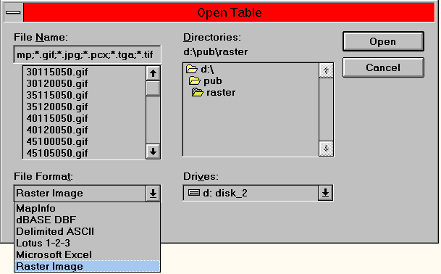
The task of registering your image within the GIS environment is procedurally simple. Most of the GIS software have their own unique method of performing the task (at least from a keystroke perspective), but conceptually they are all virtually similar. MapInfo has a custom set of dialogs specifically designed to support this function. You begin by opening the map file to which you plan to register the photograph. Next, select the Open Table option, but rather than use the "MapInfo" format, select the "Raster Image" option. Look at the diagram below and notice that we are selecting the bottom most option of the file type dialog.

Slide 16
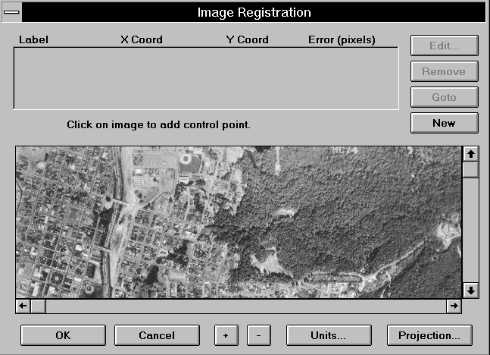
This step forces MapInfo to look for raster based images within the selected directory and return those images that possess the following file extensions: [*.bil;*.bmp;*.gif;*.jpg;*.pcx;*.tga;*.tif]. These are the raster image formats supported by the MapInfo product line. You will find that most of the more common formats are importable. Following the identification of the desired raster file, MapInfo will pop up the next dialog box that displays part of the image and which asks you to define three or more known points. The graphic below illustrates this dialog box.

Slide 17
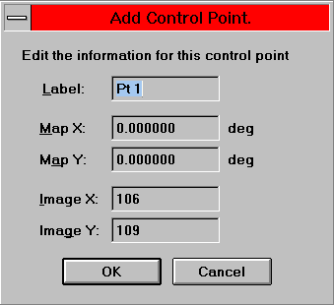
At this point, your next step is to position the cursor over a known point on the photograph and click the left mouse button. You will notice that once the cursor passes from the desktop to the photo, the cursor prompt will change to a "crosshair". This indicates that MapInfo is ready to record the pixel location of the first point. Simply point to the desired location (lower left corner first), click the left mouse button, and type in the corresponding latitude and longitude coordinates in the space provided. Be sure to enter the longitude in the "Map X" box and the latitude in the "Map Y" box. Do not change the Image X or Image Y values. These figures delineate the pixel location for the spot your have selected.

Slide 18
Next, use the slide bar to position the photo in the window so that you can see the upper right corner of the photograph and repeat the process. Continue the process and record the third known location. At this point in the procedure you have the option of altering the "Projection Scheme" used to represent the photograph. If you are using a vector map which is portrayed in a projection scheme other than conventional latitude and longitude, you must use this option and make the necessary change. For most maps, the default value will be sufficient. It is important here to note that air photos and satellite images that were not taken from a purely vertical reference should not be used. In other words, if the camera angle was not directly perpendicular to the ground, then the photograph will possess a high degree of distortion (relative to the z axis) and the GIS software will not be able to properly register the vector map to the photograph.

Slide 19
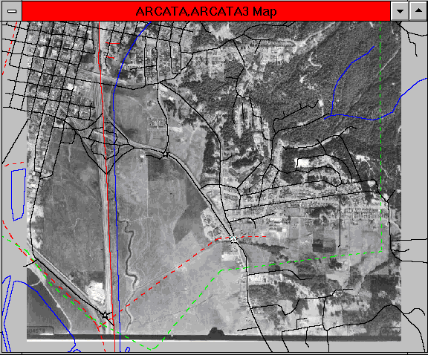
If all goes according to plan, the results of your registration effort should look like the image above. Here you can see that the photographic image has been placed as the base layer of the stack and a vector based map of the same geographic region has been layered on top. This aggregation of layers provides for a detailed representation of the geography, topography, and attributes of the region. And as promised, it looks cool.

Slide 20
As you can see however.......looks aint everthing. The photograph that was used had a substantial degree of vertical distortion and the registration accuracy was negatively impacted, because I did not ground truth three known locations. Instead, I brought up the vector map and eye-balled three intersections, determined there coordinates (approximately) and fed them into the registration dialog window. As you can see, the roads do not overlap exactly where they were supposed to and the intersections in the photo are spatially off to the left of the same intersections portrayed on the vector map. The sizing is a bit off as well. This concern about spatial accuracy that I keep harping about is not just some imagined pitfall. You really must pay close attention to the degree of exactness that you are employing. If you do not, then the consequent product of your efforts will suffer a substantial loss of spatial integrity.

